Slide 2
Introduction to the PnP Initiative with SharePoint

Slide 3

About me
Gautam Sheth
Technical Consultant at Rapid Circle India
https://github.com/gautamdsheth
https://gautamdsheth.wordpress.com/
https://twitter.com/gautamdsheth
https://www.linkedin.com/in/gautamdsheth
Notes:
Technical consultant at RC India
Contributor to PnP and SharePoint Stack Exchange
Currently focusing on the Digital Workplace. He currently takes ingredients from the Modern SharePoint stack and cooks up solutions using SharePoint Framework, Site Designs and multiple PnP
projects. He loves to give back to the community and is often found wandering the SharePoint Stack Exchange Network and PnP GitHub repositories contributing stuff.
Work on various stuff like PnP CSOM, PnP PowerShell, PnPJS , PnP Reusable controls, Office 365 CLI etc.

Slide 4
Why am I here ?
To give introduction about PnP
Why we should consider PnP ?
Introduce various components available under PnP
Demo how you can benefit from using them
Motivate you to contribute back
Q & A

Slide 5
Introduction about PnP
Fully open source initiative started by Microsoft engineering and now coordinated by them along with Microsoft MVPs
It controls SharePoint development documentation, samples, reusable controls, and other relevant open-source initiatives related to SharePoint development.
Sharing is Caring.
Notes:
I remember the days in 2014, when Microsoft SharePoint Expert Vesa Juvonen initiated the idea of sampling App Model code for different scenarios. This was initially internal only, called as OFFICE AMS (App Model Samples), which was later released on codeplex. In early days, it was only MSFT employees who contributed samples and ideas to repository. But purpose was not to restrict the samples as many partners and customers have ideas (or should I say they know real world challenges in adopting SharePoint Online development model over on-premises model).
Started around 2014. Was a Microsoft internal only effort. Then became open source.
Product release lifecycle has reduce from 3 years to weekly releases.
The initial idea was to help transition customers to a cloud world from an OnPrem world. First came 2003, 2007 , 2010 and 2013 and 2016 and now 2019. But it’s a cloud first world, so cloud will always have the latest updates

Slide 6
Why we should consider PnP ?
Controls directly coming from Microsoft Engineering
Don’t reinvent the Wheel
Speed up development
Community driven ideas and questions are always welcome
Supports SharePoint on-premise 2013/2016 and will support upcoming 2019
Notes:
Not enough OOB building blocks in SPFx
Time required to create and maintain your own standard reusable code and documentation
Time required to ensure high standards
By default follows good practices and eases Future maintenance headaches
Benefit from code that was reviewed by multiple people
Help by creating issues and by submitting pull requests (bug fixes, new features, new controls)

Slide 7
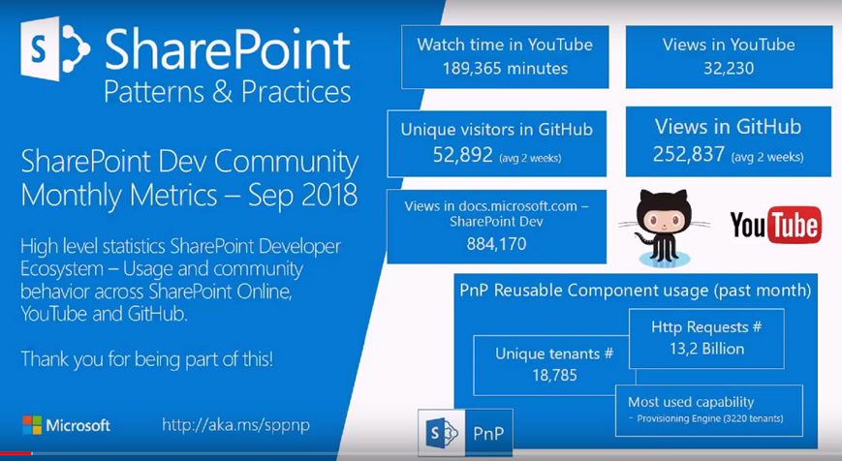
Numbers don’t lie
Notes:
Almost 19,000 unique tenants consuming PnP stuff
13.2 billion http requests made. This is just for SPO
Most used capability is PnP Provisioning engine.

Slide 8
3 pillars of PnP
SharePoint Developer
PnP Core
Install the nuget package
Front End Developer
PnP JS
Install the npm package
SharePoint Admin / Functional
PnP PowerShell
Install the nuget package
https://github.com/SharePoint/PnP-Sites-Core
https://github.com/pnp/pnpjs
https://github.com/SharePoint/PnP-PowerShell/
Install-Package SharePointPnPCoreOnline -Version 3.3.1811.0
npm install @pnp/logging @pnp/common @pnp/odata @pnp/sp --save
Install-Module SharePointPnPPowerShellOnline
Notes:
PnP Core – wrapper over CSOM.
PnPJS – wrapper of SharePoint rest api. Also supports graph api. Is fluent and quite awesome
PnP PowerShell – OOTB SPO shell is geared more towards Tenant and Site Collection level events. PnP PS uses PnP Core and is more geared towards lists, files and list items as well as tenant, site collection and web events

Slide 9
Major components
React controls
Install the npm package
Property pane controls
Install the npm package
Office 365 CLI
Install the npm package
https://sharepoint.github.io/sp-dev-fx-controls-react/
https://sharepoint.github.io/sp-dev-fx-property-controls/
https://pnp.github.io/office365-cli/
npm i @pnp/spfx-property-controls --save
npm install @pnp/spfx-controls-react --save
npm i –g @pnp/office365-cli
Notes:
React controls – reusable React controls for SPFx webparts and extensions. Easily render people, managed metadata, files etc in React SPFx webpart
Property pane controls – reusable React controls for SPFx webparts, extends OOTB property pane controls.
Open source , Common project requirements , Use Office UI Fabric, Rich user experience , Common project requirements, Very simple to configure and use and extend
Office 365 CLI – Cross platform management of O365 tenant, very useful in case you want to upgrade SPFx solutions. Compare with PnP Powershell

Slide 10
Demo Time
Notes:
https://tenant.sharepoint.com/sites/testteam/ Add-PnPListItem
Set-PnPListItem -List "Demo List" -Identity 1 -Values @{"Title" = "Test Title";}
Get-PnPUserProfileProperty -Account ‘Stevens@tenant.onmicrosoft.com','AlexW@tenant.OnMicrosoft.com’
Set-PnPUserProfileProperty -Account 'Stevens@tenant.onmicrosoft.com' -Property 'SPS-Location' -Value ‘Ahmedabad'
Get-PnPSearchCrawlLog -ContentSource Sites -LogLevel Error -RowLimit 10
Get-PnPSearchCrawlLog -ContentSource UserProfiles -Filter “mar"
Get-PnPSearchCrawlLog -ContentSource Sites -Filter "https://tenant.sharepoint.com/sites/BootCampDemoCommSite112/Shared%20Documents/"
Get-PnPTenantSite -Template SITEPAGEPUBLISHING#0
$webpartXML = [IO.File]::ReadAllText("C:\Users\GautamSheth\Desktop\highlightedContent.webpart")
Add-PnPWebPartToWebPartPage -ServerRelativePageUrl "/sites/TestTeam/Pages/TestPage.aspx" -Xml $webpartXML -ZoneId "testWebpartZone" -ZoneIndex 0
Connect-PnPOnline –Url “https://tenant.sharepoint.com” -Scopes "User.Read","User.ReadBasic.All“,”Group.ReadWrite.All”
$accessToken = Get-PnPAccessToken
$apiUrl = "https://graph.microsoft.com/v1.0/me"
$myProfile = Invoke-RestMethod -Headers @{Authorization = "Bearer $accessToken"} -Uri $apiUrl -Method Get
Stevens@tenant.onmicrosoft.com
AlexW@tenant.OnMicrosoft.com
MeganB@tenant.OnMicrosoft.com
MiriamG@tenant.OnMicrosoft.com

Slide 11
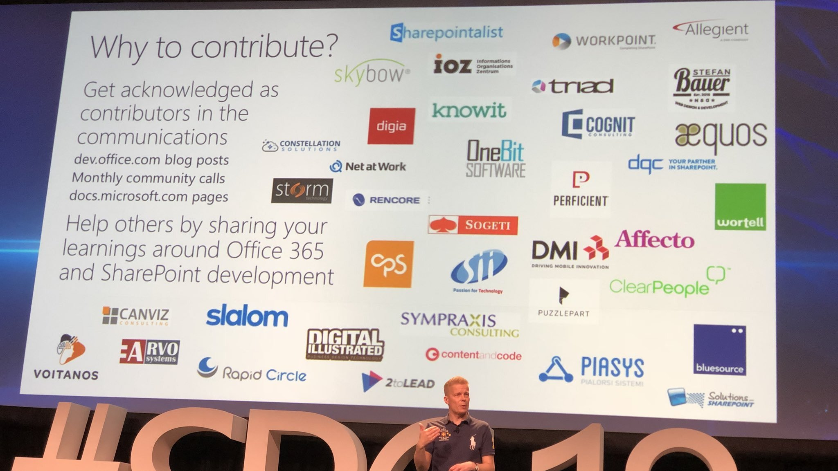

Slide 12
Questions / AMA ?
RC India is hiring, do get in touch with me or Purvin.

Slide 13
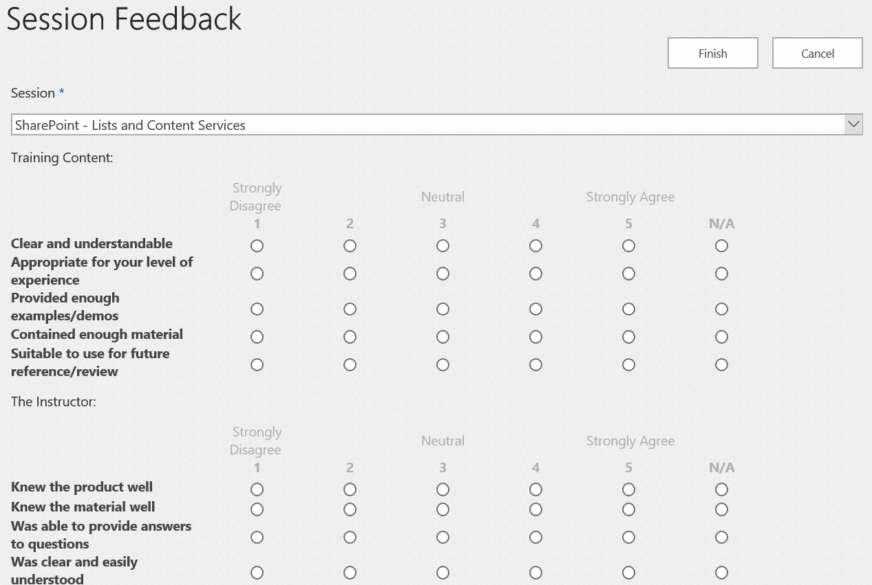
THANK YOU !
Please give us your feedback ☺
Rate each session with
SPS Events Portal from
https://bit.ly/2DvoGMS

